Slide 1



“Capacity Building for Statistician on Modeling Financial and Agricultural Data Using R”
Introduction to R for Time Series Analysis
Monday Osagie Adenomon
Department of Statistics & NSUK-LISA Stat Lab
Nasarawa State University, Keffi, Nigeria
adenomonmo@nsuk.edu.ng
Virtual, September 28-30, 2020

Slide 2
What is Time Series? Time series is a series of measurements over time usually at regular intervals of a random variable. A prime concern of the time series is the forecasting of future values using methods such as exponential smoothing, Holt-Winters forecasting or Box-Jenkins methods (Cooray, 2008).

Slide 3
Components and Uses of Time Series
The observed movement and fluctuations of many such series are composed of four different components namely: secular trend, seasonal variation, cyclical variation and irregular variation. Uses of Time Series are:
It helps in the analysis of past behavior of a variable
It helps in forecasting
It helps in evaluation of current achievement
It helps in making comparative studies

Slide 4
Applications of Time Series
Time series have always been used in the field of econometrics but can also be applied in virtually all fields (Kirchgassner and Wolters, 2007). Such as engineering, geophysics, business, finance, economics, medical studies, meteorology, quality control, social sciences and agriculture.

Slide 5
Introduction to R
R is a system for statistical analyses and graphics created by Ihaka & Gentleman (1996). R is both a software and a language considered as a dialect of the S language created by the AT&T Bell laboratories and is freely distributed under the terms of the GNU General Public License .
R is a language and environment for statistical computing and graphics, provides a wide variety of statistical methods (time series analysis, linear and nonlinear modeling, classical statistical tests, and so on) and graphical techniques, and is highly extensible.

Slide 6
Advantages of R
According to Paradis, (2005), the major advantages of R are
R has many functions and packages for statistical analyses and graphics
R language allows the user to program loops to successively analyze several data sets,
It is possible in R to combine in a single program different statistical functions to perform more complex analysis.

Slide 7
R download
R setup can be downloaded from https://cran.r-project.org
As at today 16-09-2020 R. 4.0.2 for Windows and Mac
You can also download R studio from https://rstudio.com
You can down Tinn-R editor from https://tinn-r.soft112.com
Packages are install into R through online

Slide 8
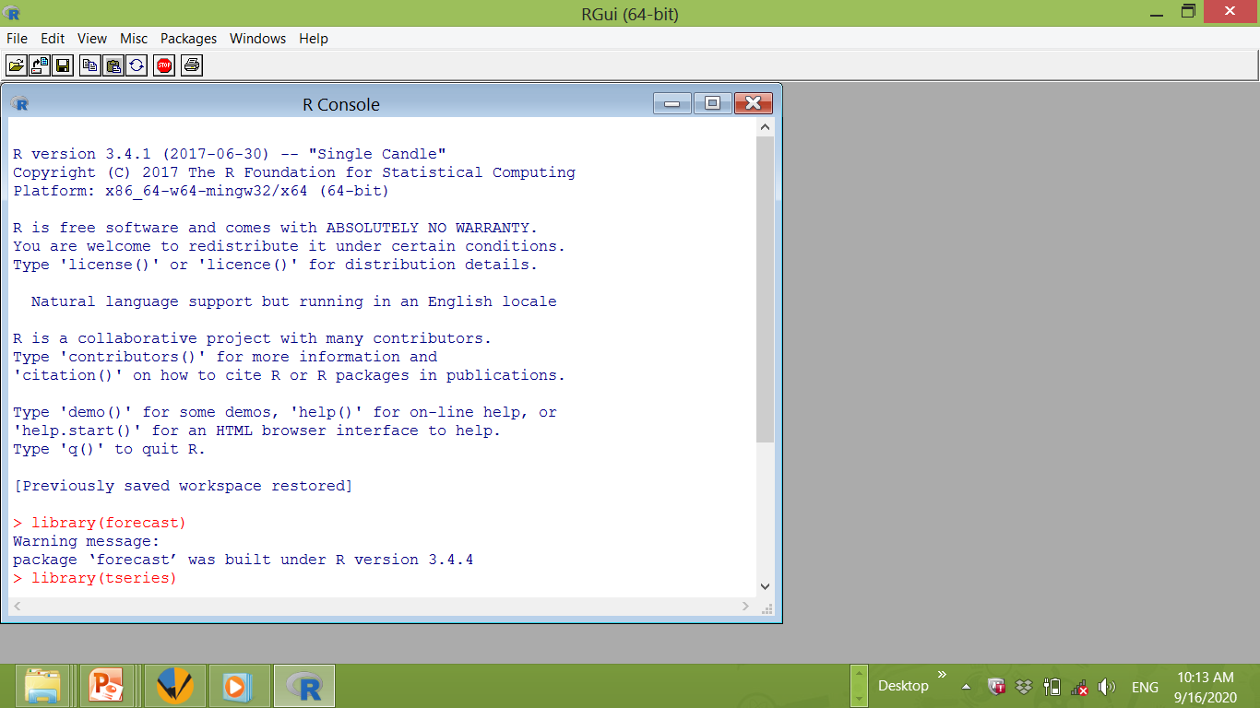
R Console

Slide 9
Univariate Time Series Analysis
The following R packages would be used
TTR
tseries
lmtest
forecast
Stats
fBasics

Slide 10
Example 1: Annual Inflation Rates in Nigeria
year | Inflation Rates
1970 | 13.8
1971 | 15.7
1972 | 3.2
1973 | 5.4
1974 | 13.2
1975 | 34.4
1976 | 23.7
1977 | 15.6
1978 | 16.6

Slide 11
Data Entry, Time Plot and Analysis
The table in example 1 can be enter directly in R since the series is short
Infla<-ts(c(13.8,15.7,3.2,5.4,13.2,34.4,23.7,15.6,16.6),start= c(1970,1))
Infla
Time Series:
Start = 1970
End = 1978
Frequency = 1
[1] 13.8 15.7 3.2 5.4 13.2 34.4 23.7 15.6 16.6

Slide 12
Time Plot
plot(Infla)

Slide 13
ACF and PACF
acf(Infla)

Slide 14
pacf(Infla)

Slide 15
ADF Unit Root Testing
ADF Test at level
adf.test(Infla)
Augmented Dickey-Fuller Test
data: Infla
Dickey-Fuller = -4.3187, Lag order = 2,
p-value = 0.01214
alternative hypothesis: stationary

Slide 16
ADF Test at first difference
adf.test(diff(Infla))
Augmented Dickey-Fuller Test
data: diff(Infla)
Dickey-Fuller = -1.8109, Lag order = 1, p-value = 0.6444
alternative hypothesis: stationary

Slide 17
Moving Average
We want to obtain simple moving average of order 4 for the inflation data from above
InflaSMA2<-SMA(Infla, n=2)
InflaSMA2
Time Series:
Start = 1970
End = 1978
Frequency = 1
[1] NA 14.75 9.45 4.30 9.30 23.80 29.05 19.65 16.10

Slide 18
plot(InflaSMA2)

Slide 19
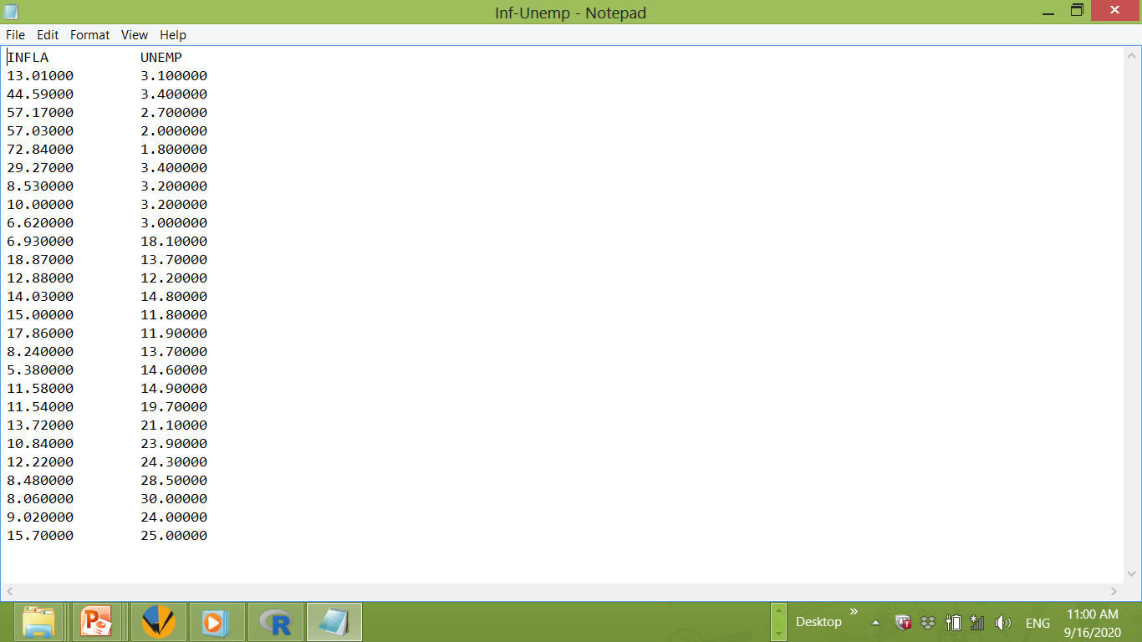
To Read data from a File: from a text file

Slide 20
To read in data from a file: Eco<-ts(read.table("C:/Users/ADENOMON/Desktop/Inf-Unemp.txt",header=T),start=c(1981,1),freq=1)
The file name and file path
Read the variable names
Date and frequency
The name of the data or table

Slide 21
Time Series:
Start = 1981
End = 2006
Frequency = 1
INFLA UNEMP
1981 13.01 3.1
1982 44.59 3.4
1983 57.17 2.7
1984 57.03 2.0
1985 72.84 1.8
1986 29.27 3.4
1987 8.53 3.2
1988 10.00 3.2
1989 6.62 3.0
1990 6.93 18.1
1991 18.87 13.7
1992 12.88 12.2
1993 14.03 14.8
1994 15.00 11.8
1995 17.86 11.9
1996 8.24 13.7
1997 5.38 14.6
1998 11.58 14.9
1999 11.54 19.7
2000 13.72 21.1
2001 10.84 23.9
2002 12.22 24.3
2003 8.48 28.5
2004 8.06 30.0
2005 9.02 24.0
2006 15.70 25.0

Slide 22
fit1=Arima(Eco[,1],order=c(1,1,0),include.constant=TRUE)
summary(fit1)
Series: Eco[, 1]
ARIMA(1,1,0) with drift
Coefficients:
ar1 drift
0.1484 0.3691
s.e. 0.2244 3.0128
sigma^2 estimated as 177.2: log likelihood=-99.16
AIC=204.32 AICc=205.46 BIC=207.97
Training set error measures:
ME RMSE MAE MPE MAPE MASE
Training set -0.1909011 12.51987 7.229488 -12.97802 41.55928 0.9540101
ACF1
Training set -0.02100178

Slide 23
library(lmtest)
coeftest(fit1)
z test of coefficients:
Estimate Std. Error z value Pr(>|z|)
ar1 0.14837 0.22444 0.6610 0.5086
drift 0.36907 3.01279 0.1225 0.9025

Slide 24
acf(fit1$residuals,main="ARIMA(1,1,0) Residuals")

Slide 25
Library(fBasics)
jarqueberaTest(fit1$residuals)
Title:
Jarque - Bera Normalality Test
Test Results:
STATISTIC:
X-squared: 42.6499
P VALUE:
Asymptotic p Value: 5.479e-10
Description:
Wed Sep 16 12:46:35 2020 by user: ADENOMON

Slide 26
Box.test(fit1$residuals,lag=12,type="Ljung-Box")
Box-Ljung test
data: fit1$residuals
X-squared = 9.6247, df = 12, p-value = 0.6489
Box.test(fit1$residuals,lag=24,type="Ljung-Box")
Box-Ljung test
data: fit1$residuals
X-squared = 12.497, df = 24, p-value = 0.9737

Slide 27
Forecast
Out of sample forecast for fit1 model for 12 step ahead
forecast(fit1,h=12)
Point Forecast Lo 80 Hi 80 Lo 95 Hi 95
2007 17.00540 -0.05380025 34.06459 -9.084393 43.09518
2008 17.51339 -8.46336729 43.49014 -22.214629 57.24140
2009 17.90307 -14.86003480 50.66617 -32.203774 68.00991
2010 18.27520 -20.12112912 56.67153 -40.446917 76.99731
2011 18.64472 -24.66192727 61.95137 -47.587083 84.87653
2012 19.01386 -28.70094838 66.72867 -53.959644 91.98737
2013 19.38295 -32.36594603 71.13184 -59.760154 98.52604
2014 19.75202 -35.73846088 75.24250 -65.113346 104.61738
2015 20.12109 -38.87415517 79.11634 -70.104352 110.34653
2016 20.49016 -41.81300568 82.79333 -74.794311 115.77464
2017 20.85924 -44.58486779 86.30334 -79.228883 120.94735
2018 21.22831 -47.21273590 89.66935 -83.443236 125.89985

Slide 28
ARIMAX
fit2=Arima(Eco[,1],order=c(1,1,1),xreg=Eco[,2],include.constant=TRUE)
summary(fit2)
coeftest(fit2)
acf(fit2$residuals,main="ARIMAX(1,1,1) Residuals")
jarqueberaTest(fit2$residuals)
Box.test(fit2$residuals,lag=12,type="Ljung-Box")
Box.test(fit2$residuals,lag=24,type="Ljung-Box")

Slide 29
fit2=Arima(Eco[,1],order=c(1,1,1),xreg=Eco[,2],include.constant=TRUE)
summary(fit2)
Series: Eco[, 1]
Regression with ARIMA(1,1,1) errors
Coefficients:
ar1 ma1 drift xreg
-0.7244 0.9531 0.7963 -0.8261
s.e. 0.5199 0.5856 2.8498 0.7837
sigma^2 estimated as 175.7: log likelihood=-98.27
AIC=206.54 AICc=209.7 BIC=212.63
Training set error measures:
ME RMSE MAE MPE MAPE MASE
Training set 0.05029308 11.91105 7.305693 -6.197063 45.73861 0.9640661
ACF1
Training set -0.0003158381

Slide 30
coeftest(fit2)
z test of coefficients:
Estimate Std. Error z value Pr(>|z|)
ar1 -0.72436 0.51987 -1.3934 0.1635
ma1 0.95308 0.58564 1.6274 0.1036
drift 0.79627 2.84976 0.2794 0.7799
xreg -0.82605 0.78367 -1.0541 0.2918

Slide 31
acf(fit2$residuals,main="ARIMAX(1,1,1) Residuals")

Slide 32
jarqueberaTest(fit2$residuals)
Title:
Jarque - Bera Normalality Test
Test Results:
STATISTIC:
X-squared: 36.8804
P VALUE:
Asymptotic p Value: 9.807e-09
Description:
Thu Sep 17 10:32:22 2020 by user: ADENOMON

Slide 33
Box.test(fit2$residuals,lag=12,type="Ljung-Box")
Box-Ljung test
data: fit2$residuals
X-squared = 10.408, df = 12, p-value = 0.5802
Box.test(fit2$residuals,lag=24,type="Ljung-Box")
Box-Ljung test
data: fit2$residuals
X-squared = 13.62, df = 24, p-value = 0.9548

Slide 34
Modeling seasonal data can also be implemented in R

Slide 35
Read monthly inflation Rate in Nigeria from Jan. 1996 to Dec 2019 into R
Inflarate<-ts(read.table("C:/Users/ADENOMON/Desktop/MInflaR.txt",header=T),start=c(1996,1),freq=12)
Inflarate
Jan Feb Mar Apr May Jun Jul Aug Sep Oct Nov Dec
1996 47.56 43.65 41.90 31.84 31.04 28.84 29.51 26.71 23.66 24.63 20.86 14.31
1997 14.32 13.35 13.75 17.09 12.85 11.65 8.31 7.71 6.53 6.34 8.11 10.21
1998 8.82 8.19 6.96 5.04 4.43 6.34 8.58 7.33 6.98 9.02 10.86 11.91
1999 14.29 14.38 13.55 11.58 11.36 8.28 3.98 0.76 2.24 1.48 -0.04 0.22
2000 -2.49 -1.73 -1.43 -0.05 2.17 5.87 6.67 13.10 15.51 17.08 15.38 14.53
2001 17.64 18.59 18.20 23.23 22.96 16.06 19.00 18.71 19.12 19.33 17.43 16.49
2002 18.55 17.99 17.38 12.76 10.18 12.22 15.57 12.28 9.97 5.37 12.15 12.17
2003 10.60 7.30 5.90 8.30 8.70 14.00 12.90 12.40 18.40 23.60 21.30 23.80
2004 22.40 24.80 22.50 17.50 19.80 14.10 10.70 13.00 9.10 10.70 10.00 10.00
2005 9.80 10.90 16.30 17.90 16.80 18.60 26.10 28.20 24.30 18.60 15.10 11.60
2006 10.70 10.80 12.00 12.60 10.50 8.50 3.00 3.70 6.30 6.10 7.80 8.50

Slide 36
2007 8.00 7.10 5.20 4.20 4.60 6.40 4.80 4.20 4.10 4.60 5.20 6.60
2008 8.60 8.00 7.80 8.20 9.70 12.00 14.00 12.40 13.00 14.70 14.80 15.10
2009 14.00 14.60 14.40 13.30 13.20 11.20 11.10 11.00 10.40 11.60 12.40 13.90
2010 14.40 15.60 14.80 15.00 12.90 14.10 13.00 13.70 13.60 13.40 12.80 11.80
2011 12.10 11.10 12.80 11.30 12.40 10.20 9.40 9.30 10.30 10.50 10.50 10.30
2012 12.60 11.90 12.10 12.90 12.70 12.90 12.80 11.70 11.30 11.70 12.30 12.00
2013 9.00 9.50 8.60 9.10 9.00 8.40 8.70 8.20 8.00 7.80 7.90 8.00
2014 8.00 7.70 7.80 7.90 8.00 8.20 8.30 8.50 8.30 8.10 7.90 8.00
2015 8.20 8.40 8.50 8.70 9.00 9.20 9.20 9.30 9.40 9.30 9.37 9.55
2016 9.62 11.38 12.77 13.72 15.58 16.48 17.13 17.61 17.85 18.33 18.48 18.55
2017 18.72 17.78 17.26 17.24 16.25 16.10 16.05 16.01 15.98 15.91 15.90 15.37
2018 15.13 14.33 13.34 12.48 11.61 11.23 11.14 11.23 11.28 11.26 11.28 11.44
2019 11.37 11.31 11.25 11.37 11.40 11.22 11.08 11.02 11.24 11.61 11.85 11.98

Slide 37
plot(Inflarate)

Slide 38
Decomposition using Additive model
DecompInfla<-decompose(Inflarate)
plot(DecompInfla)

Slide 39
To obtain the seasonal component using additive model
DecompInfla$seasonal
Jan Feb Mar Apr May Jun Jul Aug Sep Oct
1996 0.10453955 0.11852506 0.10249245 0.13249245 -0.05672856 -0.15966335 -0.18962711 -0.19113074 -0.13919233 0.11993810
1997 0.10453955 0.11852506 0.10249245 0.13249245 -0.05672856 -0.15966335 -0.18962711 -0.19113074 -0.13919233 0.11993810
1998 0.10453955 0.11852506 0.10249245 0.13249245 -0.05672856 -0.15966335 -0.18962711 -0.19113074 -0.13919233 0.11993810
1999 0.10453955 0.11852506 0.10249245 0.13249245 -0.05672856 -0.15966335 -0.18962711 -0.19113074 -0.13919233 0.11993810
2000 0.10453955 0.11852506 0.10249245 0.13249245 -0.05672856 -0.15966335 -0.18962711 -0.19113074 -0.13919233 0.11993810
2001 0.10453955 0.11852506 0.10249245 0.13249245 -0.05672856 -0.15966335 -0.18962711 -0.19113074 -0.13919233 0.11993810
Nov Dec
1996 0.11999245 0.03836202
1997 0.11999245 0.03836202
1998 0.11999245 0.03836202
1999 0.11999245 0.03836202
2000 0.11999245 0.03836202
2001 0.11999245 0.03836202

Slide 40
To obtain the seasonal indices using additive model
DecompInfla$figure
0.10453955 0.11852506 0.10249245 0.13249245 -0.05672856
-0.15966335 -0.18962711 -0.19113074 -0.13919233 0.11993810 0.11999245 0.03836202

Slide 41
To obtain seasonal adjusted series using additive model
Adjustedseasonal<-Inflarate-DecompInfla$seasonal
Jan Feb Mar Apr May Jun Jul Aug Sep Oct Nov
1996 47.4554604 43.5314749 41.7975075 31.7075075 31.0967286 28.9996633 29.6996271 26.9011307 23.7991923 24.5100619 20.7400075
1997 14.2154604 13.2314749 13.6475075 16.9575075 12.9067286 11.8096633 8.4996271 7.9011307 6.6691923 6.2200619 7.9900075
1998 8.7154604 8.0714749 6.8575075 4.9075075 4.4867286 6.4996633 8.7696271 7.5211307 7.1191923 8.9000619 10.7400075
Dec
1996 14.2716380
1997 10.1716380
1998 11.8716380

Slide 42
plot(Adjustedseasonal)

Slide 43
Decomposition using Multiplicative Model
DecompInfla1<-decompose(Inflarate,"multiplicative")
plot(DecompInfla1)

Slide 44
To obtain the seasonal component using Multiplicative model
DecompInfla1$seasonal
Jan Feb Mar Apr May Jun Jul
1996 0.9271024 0.9752039 0.9891401 1.0102692 1.0170295 1.0385963 0.9994201
1997 0.9271024 0.9752039 0.9891401 1.0102692 1.0170295 1.0385963 0.9994201
1998 0.9271024 0.9752039 0.9891401 1.0102692 1.0170295 1.0385963 0.9994201
1999 0.9271024 0.9752039 0.9891401 1.0102692 1.0170295 1.0385963 0.9994201
2000 0.9271024 0.9752039 0.9891401 1.0102692 1.0170295 1.0385963 0.9994201
Aug Sep Oct Nov Dec
1996 0.9812200 0.9986539 1.0103650 1.0140874 1.0389122
1997 0.9812200 0.9986539 1.0103650 1.0140874 1.0389122
1998 0.9812200 0.9986539 1.0103650 1.0140874 1.0389122
1999 0.9812200 0.9986539 1.0103650 1.0140874 1.0389122
2000 0.9812200 0.9986539 1.0103650 1.0140874 1.0389122

Slide 45
To obtain the seasonal indices using multiplicative model
DecompInfla1$figure
0.9271024 0.9752039 0.9891401 1.0102692 1.0170295 1.0385963 0.9994201 0.9812200 0.9986539 1.0103650 1.0140874 1.0389122

Slide 46
To obtain seasonal adjusted series using multiplicative model
Adjustedseasonal1<-Inflarate-DecompInfla1$seasonal
Jan Feb Mar Apr May Jun Jul Aug Sep Oct Nov
1996 46.6328976 42.6747961 40.9108599 30.8297308 30.0229705 27.8014037 28.5105799 25.7287800 22.6613461 23.6196350 19.8459126
1997 13.3928976 12.3747961 12.7608599 16.0797308 11.8329705 10.6114037 7.3105799 6.7287800 5.5313461 5.3296350 7.0959126
1998 7.8928976 7.2147961 5.9708599 4.0297308 3.4129705 5.3014037 7.5805799 6.3487800 5.9813461 8.0096350 9.8459126
Dec
1996 13.2710878
1997 9.1710878
1998 10.8710878
1999 -0.8189122

Slide 47
plot(Adjustedseasonal1)

Slide 48
Holt-Winter Smoothing
InflaHW<- HoltWinters(Inflarate, alpha=0.3,beta=0.1,gamma=0.1)
InflaHW
Holt-Winters exponential smoothing with trend and additive seasonal component.
Call:
HoltWinters(x = Inflarate, alpha = 0.3, beta = 0.1, gamma = 0.1)
Smoothing parameters:
alpha: 0.3
beta : 0.1
gamma: 0.1
Coefficients:
[,1]
a 10.79740911
b -0.05249446
s1 -0.17798980
s2 -0.45358476
s3 -0.41949378
s4 0.38872295
s5 0.21181303
s6 0.23654241
s7 0.32900421
s8 0.44091605
s9 0.50028857
s10 1.17753534
s11 1.11723809
s12 0.27478063

Slide 49
Fitted values from Holt-Winters exponential smoothing
InflaHW$fitted
xhat level trend season
Jan 1997 24.4762260 29.21793561 -1.606397145 -3.13531250
Feb 1997 20.2232742 24.56467067 -1.911083923 -2.43031250
Mar 1997 17.9494265 20.59160447 -2.117282151 -0.52489583
Apr 1997 19.2621669 17.21449438 -2.243264946 4.29093750
May 1997 13.3554202 14.31957935 -2.308429954 1.34427083
Jun 1997 10.3822849 11.85952333 -2.323592560 0.84635417
Jul 1997 8.3687050 9.91624529 -2.285561109 0.73802083
Aug 1997 5.9112712 7.61307268 -2.287322259 0.58552083
Sep 1997 3.6029461 5.86536904 -2.233360396 -0.02906250
Oct 1997 5.0930135 4.51012480 -2.145548781 2.72843750
Nov 1997 0.9614703 2.73867196 -2.108139186 0.33093750
Dec 1997 -3.8634874 2.77509169 -1.893683295 -4.74489583

Slide 50
plot(InflaHW$fitted)

Slide 51
Forecast from Holt Winters model
Inflafor<-forecast(InflaHW,h=12)
Inflafor
Point Forecast Lo 80 Hi 80 Lo 95 Hi 95
Jan 2020 10.56692 5.663333 15.47052 3.0675282 18.06632
Feb 2020 10.23884 5.075141 15.40253 2.3416467 18.13602
Mar 2020 10.22043 4.763327 15.67754 1.8745097 18.56635
Apr 2020 10.97615 5.193657 16.75865 2.1325878 19.81972
May 2020 10.74675 4.608440 16.88506 1.3590148 20.13448
Jun 2020 10.71898 4.196102 17.24187 0.7430957 20.69487
Jul 2020 10.75895 3.824399 17.69350 0.1534687 21.36444
Aug 2020 10.81837 3.446654 18.19008 -0.4556958 22.09243
Sep 2020 10.82525 2.992383 18.65811 -1.1540851 22.80458
Oct 2020 11.45000 3.133386 19.76661 -1.2691627 24.16916
Nov 2020 11.33721 2.515511 20.15890 -2.1544129 24.82883
Dec 2020 10.44226 1.095285 19.78923 -3.8527034 24.73722

Slide 52
SARIMA Model
FitA=Arima(variable,order=c(p,q,r), seasonal=list(order=c(P,Q,R),period=12)
FitB=Arima(variable,order=c(p,q,r), seasonal=list(order=c(P,Q,R),period=4)
Period 12 for monthly data and period 4 for quarterly data

Slide 53
Dividing the series into train and test
Inflarate<-ts(read.table("C:/Users/ADENOMON/Desktop/MInflaR.txt",header=T),start=c(1996,1),end=c(2019,12),freq=12)
inflatrain<-ts(Inflarate[1:276],start=c(1996,1),freq=12)
inflatest<-ts(Inflarate[277:288],start=c(2019,1),freq=12)

Slide 54
Plot of the training series
plot(inflatrain)

Slide 55
Plot of the testing series
plot(inflatest)

Slide 56
FitA=Arima(inflatrain,order=c(1,1,1), seasonal=list(order=c(1,1,1),period=12))
summary(FitA)
Series: inflatrain
ARIMA(1,1,1)(1,1,1)[12]
Coefficients:
ar1 ma1 sar1 sma1
0.8176 -0.7093 -0.3316 -1.0000
s.e. 0.2126 0.2495 0.0621 0.0412
sigma^2 estimated as 3.97: log likelihood=-575.21
AIC=1160.42 AICc=1160.65 BIC=1178.28
Training set error measures:
ME RMSE MAE MPE MAPE MASE ACF1
Training set 0.3110734 1.930246 1.290852 -10.35587 45.55828 0.212327 0.01282109

Slide 57
coeftest(FitA)
z test of coefficients:
Estimate Std. Error z value Pr(>|z|)
ar1 0.817572 0.212583 3.8459 0.0001201 ***
ma1 -0.709339 0.249488 -2.8432 0.0044665 **
sar1 -0.331608 0.062126 -5.3376 9.417e-08 ***
sma1 -0.999996 0.041171 -24.2890 < 2.2e-16 ***
---
Signif. codes: 0 ‘***’ 0.001 ‘**’ 0.01 ‘*’ 0.05 ‘.’ 0.1 ‘ ’ 1

Slide 58
jarqueberaTest(FitA$residuals)
Title:
Jarque - Bera Normalality Test
Test Results:
STATISTIC:
X-squared: 92.5304
P VALUE:
Asymptotic p Value: < 2.2e-16
Description:
Wed Sep 23 16:48:21 2020 by user: ADENOMON

Slide 59
Box.test(FitA$residuals,lag=24,type="Ljung-Box")
Box-Ljung test
data: FitA$residuals
X-squared = 51.961, df = 24, p-value = 0.0007915

Slide 60
ACF Plot for SARIMA model residuals
acf(FitA$residuals,main="SARIMA(1,1,1)x(1,1,1) Residuals")

Slide 61
Out of sample Forecast from SARIMA Model
forecast(FitA,h=12)
Point Forecast Lo 80 Hi 80 Lo 95 Hi 95
Jan 2019 11.46409 8.8518719 14.07631 7.4690457 15.45914
Feb 2019 11.49872 7.6015289 15.39591 5.5384807 17.45896
Mar 2019 11.66771 6.6735844 16.66183 4.0298565 19.30555
Apr 2019 11.47920 5.4868210 17.47158 2.3146461 20.64376
May 2019 11.41887 4.4963486 18.34139 0.8317870 22.00595
Jun 2019 11.28016 3.4812195 19.07911 -0.6472928 23.20762
Jul 2019 11.22800 2.5980366 19.85796 -1.9703893 24.42639
Aug 2019 11.04459 1.6234634 20.46572 -3.3637818 25.45297
Sep 2019 10.96016 0.7835714 21.13676 -4.6035912 26.52392
Oct 2019 11.14593 0.2462586 22.04560 -5.5236784 27.81554
Nov 2019 11.05477 -0.5383876 22.64793 -6.6754344 28.78497
Dec 2019 10.84282 -1.4166501 23.10229 -7.9064222 29.59207

Slide 62
Compare forecast with testing series
Forinflation<-forecast(FitA,h=12)
Forinflation$mean
Jan Feb Mar Apr May Jun Jul Aug
11.46409 11.49872 11.66771 11.47920 11.41887 11.28016 11.22800 11.04459
Sep Oct Nov Dec
10.96016 11.14593 11.05477 10.84282

Slide 63
accuracy(Forinflation$mean,inflatest)
ME RMSE MAE MPE
Test set 0.1345807 0.4542936 0.3114719 1.104977
MAPE ACF1 Theil's U
2.676676 0.645882 2.624723

Slide 64
Bibliography
Adenomon, M. O.(2017): Introductory to Univariate and Multivariate Time Series Analysis with Examples in R. Ibadan: University Press Plc
Cooray, T. M. J. A.(2008): Applied Time Series Analysis and Forecasting: New Delhi. Nerosa Publishing House.
Cryer, J.D., and Chan, K-S.(2008): Time Series Analysis with Applications in R(2nd ed). New York: Springer Science+Business Media, LLC.
Kirchgassner, G., and Wolters, J.(2007): Introduction to Modern Time Series Analysis. New York: Springer Berlin Heidelberg

Slide 65
THANK
YOU

